Slide 1
G. SAI KEERTHANA -18X01A05D9 M. VYNA REDDY -18X01A05F3 CH. RAKESH -19X05A0516 C. KOUSHIK GOUD -17L71A0516
CROP YIELD PREDICTION USING MACHINE LEARNING ALGORITHM

Slide 2
ABSTRACT
Agriculture is one of the major and the least paid occupation in India. Machine learning can bring a boom in the agriculture field by changing the income scenario through growing the optimum crop. This paper focuses on predicting the yield of the crop by applying various machine learning techniques. The outcome of these techniques is compared on the basis of mean absolute error. The prediction made by machine learning algorithms will help the farmers to decide which crop to grow to get the maximum yield by considering factors like temperature, rainfall, area, etc.

Slide 3
PROPOSED SYSTEM
This paper focuses on the practical application of machine learning algorithms and its quantification. The work presented here also takes into account the inconsistent data from rainfall and temperature datasets to get a consistent trend. Crop yield prediction is determined by considering all the features in contrast with the usual trend of determining the prediction considering one feature at a time.
ADVANTAGES OF PROPOSED SYSTEM: Achieving the maximum crop at minimum yield is the ultimate Aim of the project. Early detection of problems and management of that problems can help the farmers for better crop yield. For the better understanding of the crop yield, we need to study of the huge data with the help of machine learning algorithm so it will give the accurate yield for that crop and suggest the farmer for a better crop.

Slide 4
SOFTWARE REQUIREMENTS
SOFTWARE REQUIREMENTS:
Operating System: Windows
Coding Language: Python 3.7
IDLE: 3.7
HARDWARE REQUIREMENTS:
System : Pentium IV 2.4 GHz.
Hard Disk : 40 GB.
Floppy Drive : 1.44 Mb.
Monitor : 15 VGA Colour.
Mouse : Logitech.
Ram : 512 Mb.

Slide 5
ARCHITECTURE
SYSTEM ARCHITECTURE
MODULE DESCRIPTION
Upload Crop Dataset
The crop production dataset that is used to predict the name and yield of the crop is fed into classification and regression algorithms.
Preprocess Dataset
Experiments were conducted on Indian government dataset and it has been established that Random Forest Regressor gives the highest yield prediction accuracy. Sequential model that is Simple Recurrent Neural Network performs better on rainfall prediction while LSTM is good for temperature prediction. By combining rainfall, temperature along with other parameters like season and area, yield prediction for a certain district can be made.
Train Machine Learning
This focuses on district wise yield prediction according to the crop sown in the district. Yield is being predicted for given crops district wise and crops with best yield.
Upload Test Data &Predict Yield
Results reveals that Random Forest is the best classifier when all parameters are combined. This will not only help farmers in choosing the right crop to grow in the next season but also bridge the gap between technology and the agriculture sector.
u
User
Check
Unauthorised user
Upload Crop Dataset
Preprocess Dataset
Train Machine Learning
Upload Test Data & Predict Yield
End Process

Slide 6
USE CASE DIAGRAM
A use case diagram in the Unified Modeling Language (UML) is a type of behavioral diagram defined by and created from a Use-case analysis. The main purpose of a use case diagram is to show what system functions are performed for which actor. Roles of the actors in the system can be depicted.
h
Upload Crop Dataset
Preprocess Dataset
Train Machine Learning Algorithm
Upload Test Data & Predict Yield
Close

Slide 7
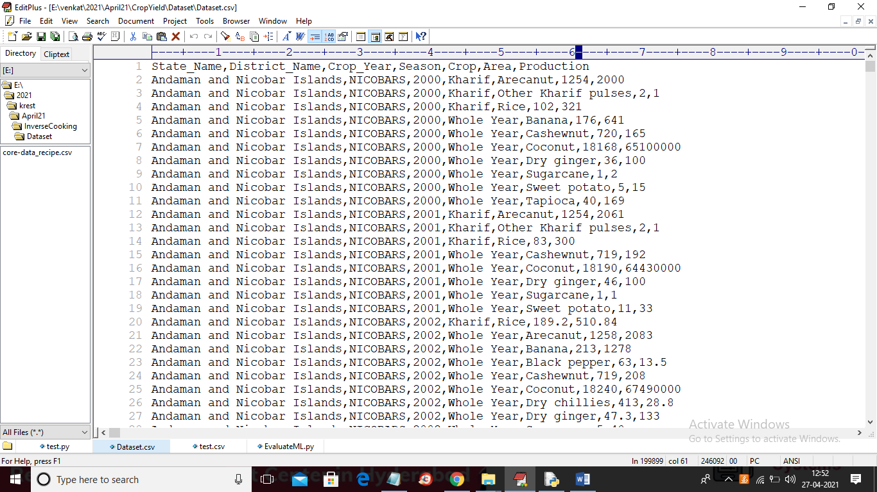
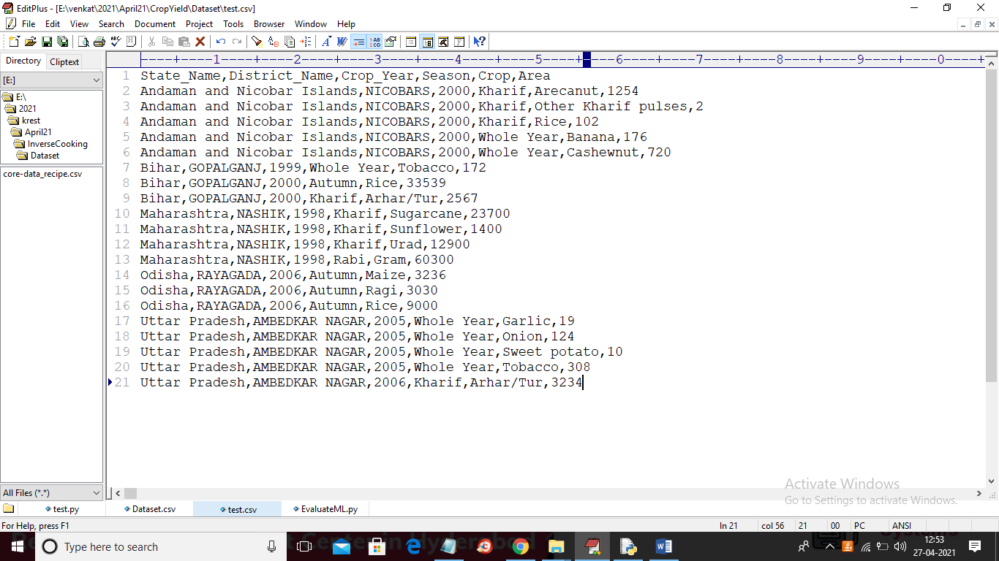
DATA SET
In above dataset first row contains column names and
other rows contains column values and in above
screen last column production we will take as class
label and other columns will be taken as training
features. After training ML with above dataset then
we will upload below test dataset to predict yield.
In above screen in test data production column is
missing and this column will be predicted by ML
algorithm.

Slide 8
TEST CASES
Module: Crop yield prediction
Test data: Area, Production
Status: Good or Poor
Summary: To predict crop production per acre
Data Attributes | Domain Value | Test Data | Status
State | Bihar Maharashtra Odisha Uttar Pradesh | Success Failure Success Success | Good Poor Good Good
District | Gopalganj Nashik Rayagada Ambedkar Nagar | Failure Failure Success Success | Poor Poor Good Good
Year | 1998-2006 | Success | Good
Season | Kharif Rabi Autumn Whole Year | Success Failure Failure Failure | Good Poor Poor Poor
Crop | Rice Gram Maize Tobacco | Failure Success Success Failure | Poor Good Good Poor

Slide 9
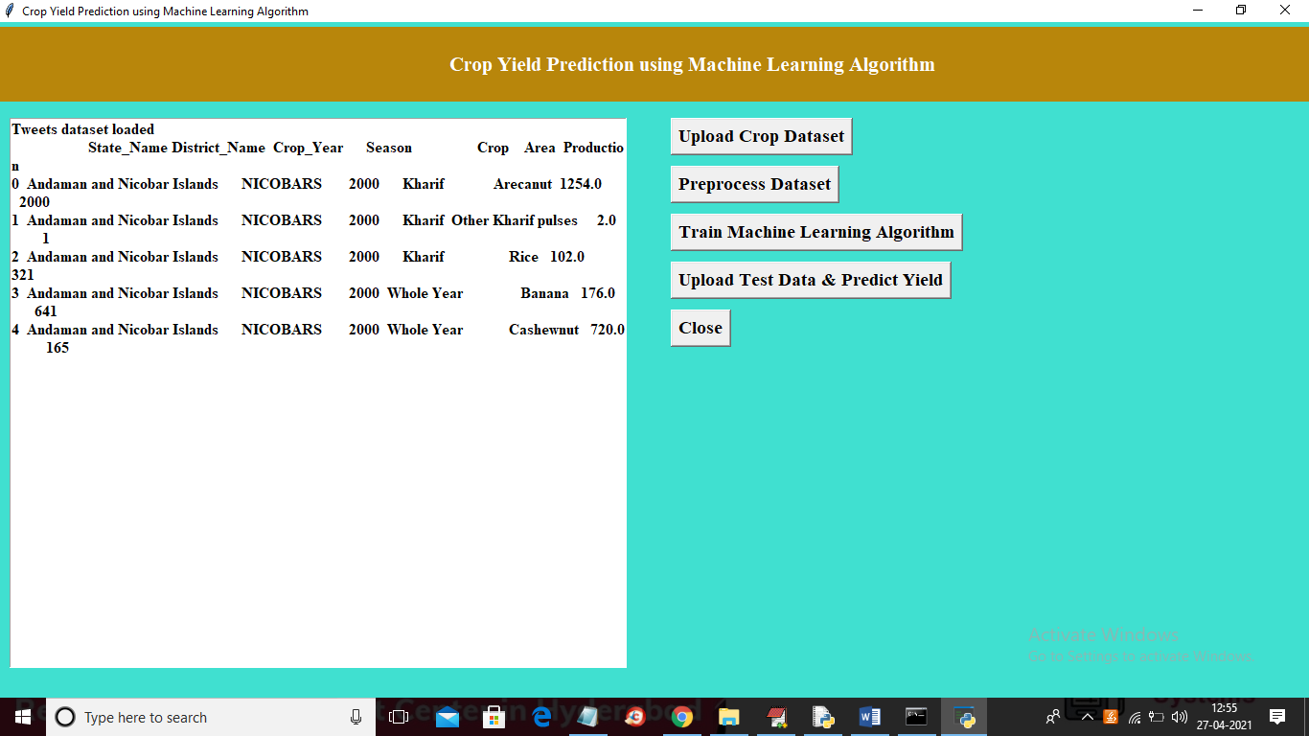
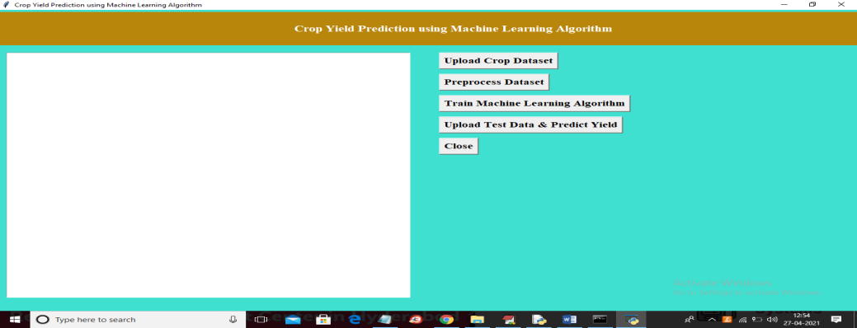
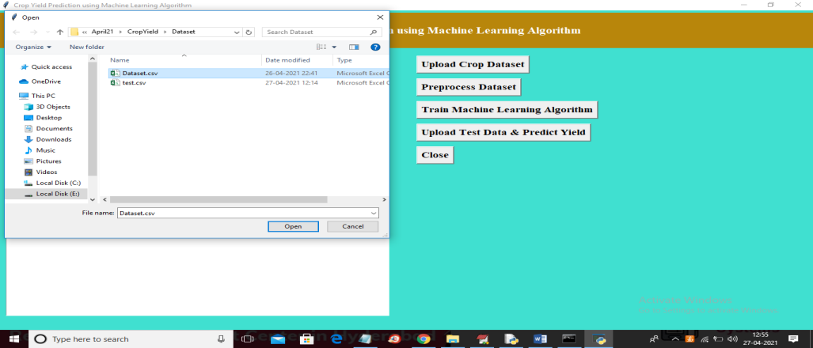
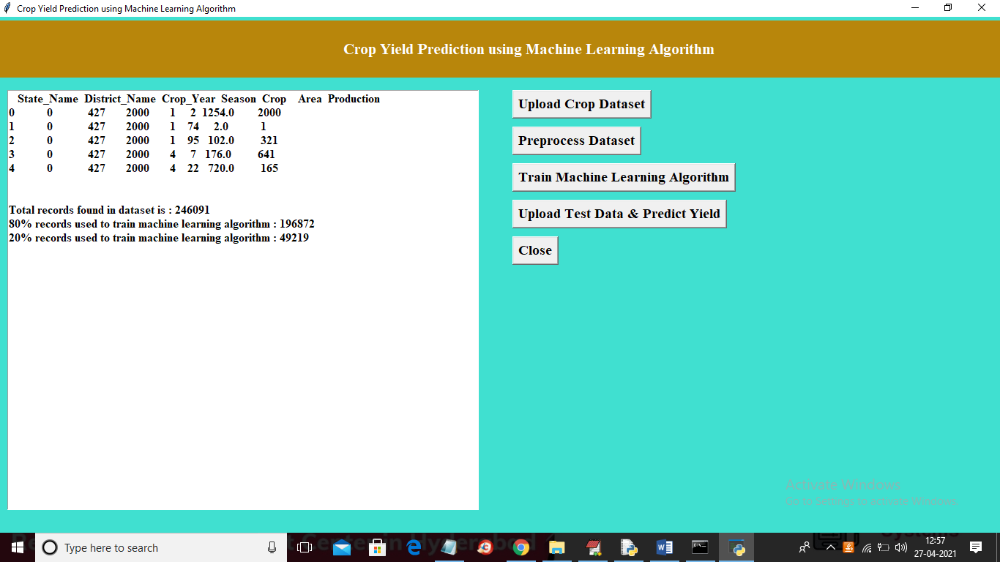
SCREENSHOTS
To run project double click on ‘run.bat’ file to get below screen
In above screen dataset loaded. So click on ‘Preprocess Dataset’ to
process dataset.
In above screen click on ‘Upload Crop Dataset’ button to upload dataset.
In above screen selecting and uploading ‘Dataset.csv’ file and then . Now click on ‘Train Machine Learning Algorithm’ button to train
click on ‘Open’ button to load dataset and to get below screen. Decision Tree Machine learning algorithm n above dataset and
then calculate prediction error rate.

Slide 10
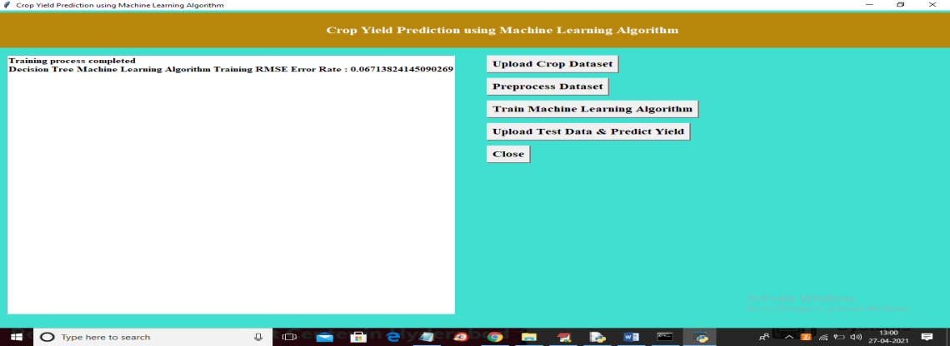

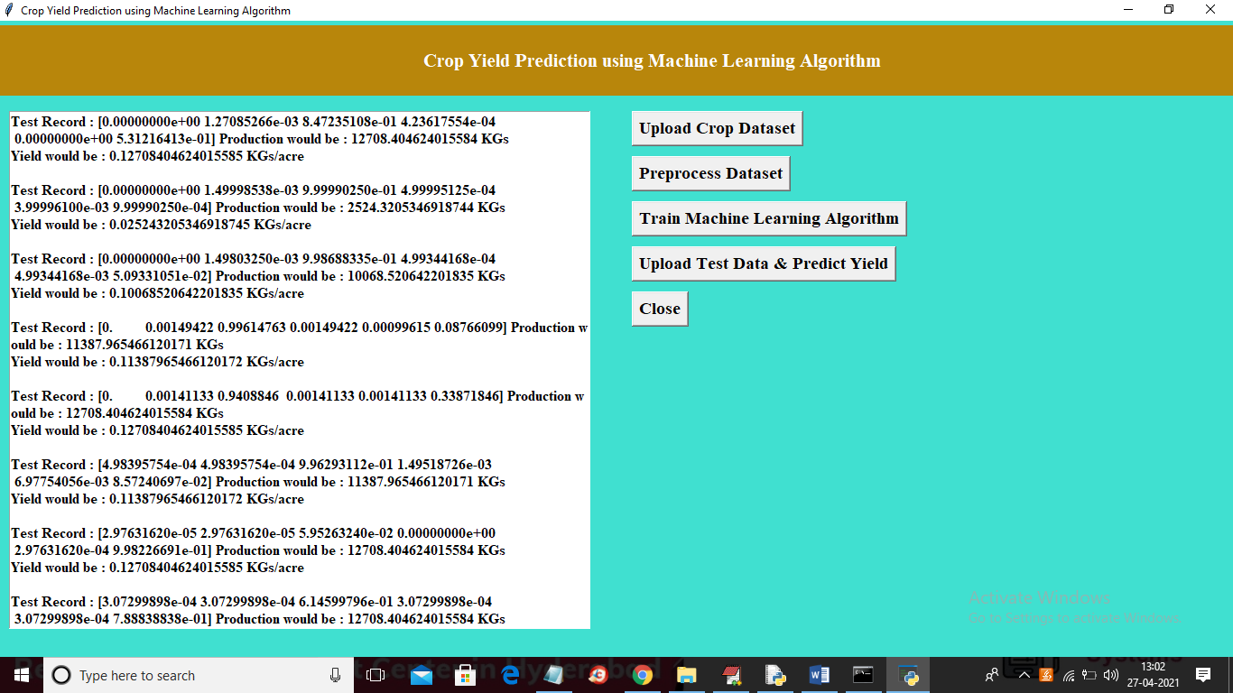
SCREENSHOTS
In above screen ML is trained and we got prediction error rate as 0.067% and now Decision Tree model is ready and now click on ‘Upload Test Data & Predict Yield’ button to upload test data and then application will predict production.
In above screen selecting and uploading ‘test.csv’ file and then In above screen each test record and its prediction is separated
click on ‘Open’ button to load test data and then application with newline. You can scroll down above text area to view all
will give below prediction result. records.

Slide 11
CONCLUSION
The system comes with a model to be precise and accurate in predicting crop yield according State, District, Crop to produce according the season the area it occupied.
It gives us an idea for the finest prediction which will be cultivate in the field according to the season in different states with yield it produced.
The algorithm Decision Tree Machine Learning Algorithm is used to see predicted yield per acre.
FUTURE ENHANCEMENTS:
Machine Learning is a crucial perspective for acquiring real-world and operative solution for crop yield issue. From a given set of predictors, ML can predict a target/outcome by using Supervised Learning.
Crop yield prediction incorporates forecasting the yield of crop per acre from past historical data which gives an overview what crop is harvested according the season in different states.

